Slide 1

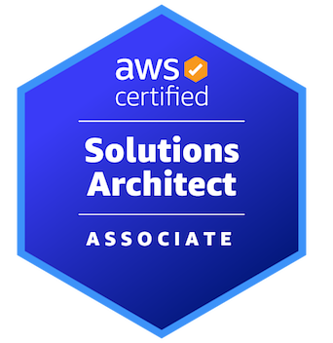

AWS CERTIFIED SOLUTIONS ARCHITECT - ASSOCIATE
Monitoring
AMBER ISRAELSEN
Developer | Technical Trainer
Notes:
m11-01 = “Module Introduction”
Hi friends! I’m Amber Israelsen and this, of course, is the AWS Certified Solutions Architect Associate course. Welcome back.

Slide 2
Course Outline (Part 1)
Course Introduction
AWS Cloud Practitioner Refresher
Authentication and Authorization – Identity and Access Management (IAM)
Compute
Elastic Load Balancing and Auto Scaling
Networking
Storage
Databases
Data Migration and Transfer
Analytics
DONE!
Notes:
We can officially cross off all of these modules in the course. Yay! We’ve covered a TON of content already, and hopefully you’re starting to see how some of the pieces fit together. And as a reminder, if you haven’t been following along with the demos, I would really encourage you to do that; it’ll make all the difference in learning and remembering.

Slide 3
Course Outline (Part 2)
Monitoring
Security and Compliance
Automation and Governance
DNS and Network Routing
Application Integration
Machine Learning
Backup and Recovery
Billing and Pricing
The Well-Architected Framework
Preparing for the Exam
Notes:
Now we’re on to our next set of modules—and I promise there’s not another slide of modules after this!
Let’s dive into Monitoring, where we’ll focus on CloudWatch and CloudTrail, and then make a quick stop on AWS Config at the end. Let’s get started.

Slide 4



Deploy my awesome app
Notes:
m11-02 = “CloudWatch Overview”
All right. So you’ve built out an awesome app, and you deploy it to AWS—out to EC2 instances, databases, what have you. The things we’ve been talking about so far in the course.

Slide 5
NOW WHAT?
Deploy my awesome app
Notes:
Now what?

Slide 6
What does website traffic look like?
How is performance?
How much bandwidth is my app using?
Are compute resources optimized?
Deploy my awesome app
Notes:
You probably have lots of questions about what’s happening with the app once it’s out in the cloud.
Like…
What does website traffic look like?
How is performance?
How much bandwidth is my app using?
Are compute resources optimized?
If you’d done any on-premises development work in the past, you might be used to just logging into various machines and checking how things are going. But you can’t really do that in the cloud.
So that’s why we have CloudWatch.

Slide 7

Amazon CloudWatch
Provides visibility into AWS resources and applications
Near-real-time metrics such as CPU, disk, GPU utilization
CloudWatch Logs allow you to collect logs from AWS and non-AWS sources, to search/extract metrics
Alarms can trigger notifications for metrics
Example: Billing alarm to notify you when you’ve hit a certain amount
Dashboards offer at-a-glance views
Notes:
CloudWatch provides visibility into all your AWS resources and applications.
You can set up metrics to measure essentially anything—like CPU, disk or GPU utilization.
CloudWatch logs allow you to collect logs from AWS or non-AWS sources, and search/extract metrics from them. For example, you want to collect application logs from an EC2 instance and then query them for certain keywords.
You can also set up alarms that can trigger emails or text messages for metrics. Say for example, you want to get an alert when you’ve hit a certain amount on your bill. I’ve personally used this one before, and it’s saved me a lot of money!
And finally, CloudWatch metrics can be displayed on a dashboard, which gives you a nice at-a-glance view of how things are going.

Slide 8
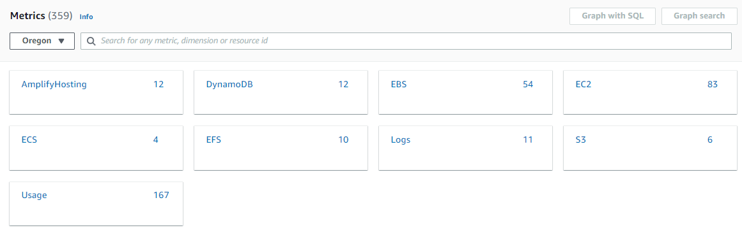
CloudWatch Metrics and Namespaces
NAMESPACES
A container for metrics
Can create your own custom namespaces
Notes:
m11-03 = “CloudWatch Metrics Overview”
Let’s dive into CloudWatch metrics a little more. Starting with namespaces (click). Your metrics live in a namespace, which is essentially a container for metrics. You’ll see here some of the standard AWS metrics that you get—they’re grouped by DynamoDB metrics or EBS metrics and what have you. You can also create your own custom namespaces if you want.

Slide 9
CloudWatch Metric
A time-ordered set of data points published to CloudWatch
Exist only in the region they were created
Notes:
And then the metrics themselves are a time-ordered set of data points published to CloudWatch. And I’ll show you an example in just a second.
And just note that these ARE region-specific. So different regions could have different AWS metrics as standard, and then if you create your own custom metrics, those will only exist in the region where they were created.
A metric represents a time-ordered set of data points that are published to CloudWatch. Think of a metric as a variable to monitor, and the data points as representing the values of that variable over time. For example, the CPU usage of a particular EC2 instance is one metric provided by Amazon EC2. The data points themselves can come from any application or business activity from which you collect data.
https://docs.aws.amazon.com/AmazonCloudWatch/latest/monitoring/cloudwatch_concepts.html

Slide 10
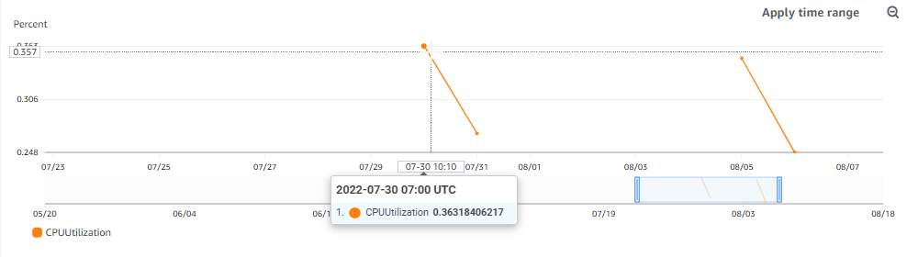
Values of the variable over time
CPUUtilization: The metric or variable to monitor
Notes:
Here’s an example metric, one for CPUUtilization (click) on an EC2 instance. So that’s the name of the metric—the thing we’re monitoring. You can think of this as a variable.
(click) And then the values of the variable that change over time, and they each have time stamps.
https://docs.aws.amazon.com/AmazonCloudWatch/latest/monitoring/cloudwatch_concepts.html
Each metric data point must be marked with a timestamp. The timestamp can be up to two weeks in the past and up to two hours into the future. If you do not provide a timestamp, CloudWatch creates a timestamp for you based on the time the data point was received.
https://stackoverflow.com/questions/46823005/cloudwatch-metrics-are-expiring

Slide 11
Basic vs. Detailed Monitoring
BASIC
DETAILED
Supported by most services, and enabled automatically
Free of charge
Metrics published at 5-minute intervals
Supported by some services, and must be manually activated
Incurs additional cost
Metrics published at 1-minute intervals
Notes:
There are two different kinds of monitoring that you can do with CloudWatch.
First is basic. This is supported by most AWS services, and is enabled automatically on those where it is. It’s free of charge. And metrics are published at 5-minute intervals.
Vs. detailed monitoring. This is only supported by some services, and it has to be manually activated. There are extra costs associated with detailed monitoring, but for that extra cost, you get metrics published more frequently, at 1 minute intervals. So this is helpful if you need to know quickly how things are performing, and you can’t wait that initial 5 minutes with basic monitoring before you start getting data.
https://docs.aws.amazon.com/AmazonCloudWatch/latest/monitoring/cloudwatch-metrics-basic-detailed.html

Slide 12
Metric Resolution
Standard resolution
Data at a granularity of 1 minute
e.g., CPUUtilization taken at 15:00:16 would have a timestamp of 15:00
High resolution
Data at a granularity of 1 second
e.g., CPUUtilization taken at 15:00:16 would have a timestamp of 15:00:16
Examples of combinations
Basic monitoring with High resolution
Data published every 5 minutes, and you can drill down to a specific second
Detailed monitoring with Standard resolution
Data published every 1 minute, and you can drill down to a specific minute
Notes:
And then related to those intervals, but slightly different, we have metric resolution.
There’s standard resolution, which gives you a granularity of 1 minute. For example, if a CPUUtilization value was captured at 15:00:16, it would have a timestamp of 15:00. So you can’t drill down to anything less than a minute.
And then high resolution, you can get as granular as 1 second. So the same CPUUtilization taken at 15:00:16 would have a timestamp of 15:00:16.
Now, I know this might be a little confusing given what we just talked about with basic vs. detailed monitoring, where we were talking about 1 minutes and 5 minutes. So how is this different or the same? Let me give you some examples where we combine the two.
-Basic monitoring with High resolution
Data published every 5 minutes, and you can drill down to a specific second
So “basic monitoring” is how often the data gets published—meaning you couldn’t see the first data until 5 minutes passed. And subsequent data, you’d only get that every 5 minutes too. But the data is captured more frequently, and you can drill down into it based on the resolution.
-Detailed monitoring with Standard resolution
Data published every 1 minute, and you can drill down to a specific minute
So again, the monitoring type—basic or detailed--is how often it’s published—1 minute or 5 minutes. Resolution is how granular it is—1 minute or 1 second.
https://docs.aws.amazon.com/AmazonCloudWatch/latest/monitoring/publishingMetrics.html
Book

Slide 13
Custom Metrics
Timestamps can be up to 2 weeks in the past or 2 hours in the future; if not specified, CloudWatch will use the date/time when metric was received
aws cloudwatch put-metric-data --metric-name Buffers --namespace MyNameSpace --unit Bytes --value 231434333 --dimensions InstanceId=1-23456789,InstanceType=m1.small
Dimensions: A name/value pair that uniquely identifies a metric
Can assign up to 10 dimensions per metric
Notes:
In addition to standard AWS metrics, you can create custom metrics. And you do that using the put-metric-data command. This is an example of issuing that command from the CLI.
Here the metric name is Buffers, it lives in MyNameSpace (remember, that’s the container), the unit of measurement is Bytes, the value you’ll see here (click), and then there are two what are called dimensions , which are name/value pairs that uniquely identify the metric. In this case, InstanceID and InstanceType. So this instance with ID 1-23456789, that’s a type m1.small has a Buffer of 231 million, 434,333 bytes. And you can have up to 10 dimensions per metric.
Also, an important note about timestamps with custom metrics (click). You can pass in a timestamp up to 2 weeks in the past, or 2 HOURS in the future. If you don’t specify anything at all, then CloudWatch will use the date/time that it received the metric. You may get a question on the exam that tests your understanding of this, so it’s a good one to make a note of.
You can assign up to 10 dimensions to a metric.
Whenever you add a unique dimension to one of your metrics, you are creating a new variation of that metric.
https://tutorialsdojo.com/amazon-cloudwatch/
For example, the following command publishes a Buffers metric with two dimensions named InstanceId and InstanceType.
https://docs.aws.amazon.com/AmazonCloudWatch/latest/monitoring/publishingMetrics.html

Slide 14
DEMO
Working with CloudWatch Metrics
Notes:
m11-04 = “DEMO: Working with CloudWatch Metrics”
In this demo, we’ll go out to the Console and cover some of the concepts we’ve talked about in the slides.
SETUP: Create an EC2 instance and have it running (or just look at metrics going back in time)
Navigate to CloudWatch
All metrics (left nav)
Here are all the different metrics that are being tracked automatically for you out of the box. Click on EC2→Per instance
We get things like CPUUtilization, NetworkPacketsIn, NetworkPacketsOut and a lot more. And you’ll also see all the instance names listed there too. And you could filter by just a single instance (under InstanceId, click the dropdown and “search for this only”).
Select CPUUtilization and look at the chart
-Zoom in (mouse over an area, draw a square)
-Might need to change the date or time range (show)
-This one is on basic monitoring, so data is published every 5 minutes, but I’m getting resolution of every 1 minute (hover over and show)
Add in metrics for NetworkIn, NetworkOut
Depending on the data displayed, you can choose different visualizations or graphs too (line, bar, etc.). And under Actions, you can download this data or use it on a dashboard, which we’ll talk about a little bit later.
You can also, incidentally, view CloudWatch metrics from other places within the Console. For example, if we go to the instance we have running, and go to the Monitoring tab, you’ll see similar output here, with some pre-chosen metrics specific to an EC2 instance. And on the top right, you’ll see that’s where you can manage detailed monitoring and enable that if you need it for this particular instance (this has a cost, so don’t do).
So those are the basics of working with metrics in CloudWatch and how to get around in the Console.

Slide 15
CloudWatch Logs
Collect logs from AWS and non-AWS sources; search and extract metrics
Log Streams
A collection of log events from the same source (e.g., a Lambda function)
Log Groups
A collection of Log Streams
A stream can only exist in one log group
Log retention can be set at 1 day to 10 years
You DO pay for storage of the logs
Notes:
m11-05 = “CloudWatch Logs Overview”
Moving on to CloudWatch Logs. Let’s cover some basic concepts then we’ll go take a look in a demo.
CloudWatch logs let you collect logs from AWS and non-AWS sources, and you can then search and extract metrics from those logs.
The hierarchy here is that you have log streams. A log stream is a collection of log events from the same source. So maybe a Lambda function. Or Route 53 or something. The same place.
Then log groups are collections of log streams. And a stream can only exist in one log group.
As far as retention periods, this can be set from 1 day to 10 years, and know that you DO pay for storage of the logs.

Slide 16
CloudWatch Logs (continued)
Sources of logs
ECS, Lambda, Elastic Beanstalk, API Gateway, VPC Flow Logs, CloudTrail, Route53, CloudWatch Logs Agent, SDK
Filters and Insights can be used to query the data
To save a filter, create a Metric Filter and it will be treated as any other metric
e.g., Search for “404” in logs, and show that on a dashboard
Notes:
Logs can come from a variety of sources, including ECS, Lambda, Elastic Beanstalk, API Gateway, VPC Flow Logs, CloudTrail and others listed on the slide here. They can also come from the SDK, so the logging you do as you’re writing code for an application.
And the power of logs really comes into play with the searching and filtering you can do in them. Just having the logs doesn’t necessarily do much for you, but you can create a filter to, say, search for “404” in the logs, and then you can display them on a dashboard. When you can extract and display data like this, then it becomes actionable, which is really the whole point.

Slide 17
DEMO
Working with CloudWatch Logs
Notes:
m11-06 = “DEMO: Working with CloudWatch Logs”
In this demo, we’ll go take a look at CloudWatch Logs and some of the ways we can query the data in our logs that are stored there.
Look at Log Groups; lots of these are created automatically by AWS
lambda, sagemaker, ecs, etc.
Click into /aws/lambda/HelloWorldFunction
This will take you to your Log Streams
Click into the Stream with timestamp 2022-06-21 18:04:18– this takes you to Log Events
Filter for ERROR (case sensitive) (should pull up 2 things)
Create metric filter (should be orange button after filter runs)
Filter name: Lambda Error
Metric namespace: MyCustomNamespace (create new the first time)
Metric name: LambdaErrorMetricFilter
Metric value: 1 (so every time we find a Lambda error, the value will be 1; 1 error)
Create
This isn’t going to show up in Metrics until something actually publishes to it, meaning there’s a Lambda error that comes through (so if we go back to Metrics, wouldn’t find it OR the namespace)
But once we DO have an error, we could pull that metric in, add it to a dashboard, create an alarm based on it or whatever else you want to do.
And then lastly, let’s take a quick look at Log Insights
This lets you query your data using a query language
Over on the right, if you click Queries and Sample queries, you can see how this works.
CloudTrail→Number of log entries by service, event type and region
Apply
Select ecs/nginx-task-definition log group (NOT “my-nginx-task-definition”)
Run
Should have 728 (or whatever) records matched (need to expand timeframe to several weeks)
You could export these results (don’t do…not interesting) or add them to a dashboard

Slide 18

Deploy my awesome app
Notes:
m11-07 = “CloudWatch Alarms Overview”
You can look at CloudWatch metrics—pulling information—but wouldn’t it be nice if you could also be alerted (click) when something important happens? More of a push model.
And yes! That’s totally possible with CloudWatch Alarms.

Slide 19

CloudWatch Alarms
Notifications can be triggered for any CloudWatch metric
Alarm states
INSUFFICIENT_DATA
OK
ALARM
Actions that can be taken on alarm
EC2: Stop, terminate, reboot or recover an instance
Auto-scaling action
SNS notification
To test alarms
aws cloudwatch set-alarm-state
Notes:
A CloudWatch alarm allows us to set up notifications that can be triggered on any CloudWatch metric. For example, if CPU usage is running really high on our instance for more than 5 minutes, then alert us.
There are three different alarm states:
insufficient_data - it will be set to this initially until the first data comes in
OK – all is well
Alarm – the conditions specified in the alarm have been met, such as CPU usage over 90% for more than 5 minutes
When an alarm is in an alarm state, there are a few things you can do. For EC2 instances, you can automatically take actions such as stopping, terminating, rebooting and, for some instance types, trying to recover them. You can also take auto-scaling actions if the instance is part of an auto-scaling group.
And, of course, you can set up an SNS notification to send an email to notify someone.
If you want to test out alarms, it’s not always easy or possible to emulate the state you’re testing for—such as really high CPU usage. So you can manually put the alarm into an alarm state by using the set-alarm-state command from the CLI.

Slide 20
DEMO
Working with CloudWatch Alarms
Notes:
m11-08 = “DEMO: Working with CloudWatch Alarms”
SETUP: Create an EC2 instance and have it running
HAVE OPEN: https://awscli.amazonaws.com/v2/documentation/api/latest/reference/cloudwatch/set-alarm-state.html#
In the upcoming video, we’ll go into the Console and create a CloudWatch alarm that monitors our EC2 instances to see if they’ve failed a status check. If they do, then the alarm will go into an alarm state.
Navigate to CloudWatch
Now let’s create an alarm. Alarms—all alarms—create alarm
Select metric
EC2→Per-Instance Metrics→
Alarm for specific instance, StatusCheckFailed_Instance, over a 5-minute period (we’re only going to get data published every 5 minutes anyway since we aren’t using detailed monitoring)…
Static, >= 1 (this means the status check failed 1 or more times within 5 minutes)
…then this is In alarm. And we want to receive a notification.
Now, we haven’t gone over the Simple Notification Service or SNS yet, but this is the AWS service that sends notifications, like emails when something triggers it.
Create new topic: EC2_Instance_Status_Check_Failed
Email: user@example.com
Create topic
You could take some type of auto scaling action here (show options) if this instance were part of an auto-scaling group.
You can also add an EC2 action here (click this), like maybe you want to stop the instance, terminate it or reboot it.
For what we’re doing, we’re just going to send an email and say next.
Alarm name: My First Alarm
Next
Create
Now, you WILL need to confirm your subscription to whatever email address you set up. I just put in a dummy email address of user@example.com, but in the real world, it would send you a confirmation email where you have to say, yes, I agree to get these emails.
But let’s at least go put this into an alarm state. I could do that by stopping the instance, but let’s do it manually so we don’t have to wait so long.
We’re going to use the set-alarm-state command, and you can find the documentation for it here: https://awscli.amazonaws.com/v2/documentation/api/latest/reference/cloudwatch/set-alarm-state.html
For instance, open CloudShell
aws cloudwatch set-alarm-state --alarm-name "My First Alarm" --state-value ALARM --state-reason "Status check failed“
If we go back to our alarm, we’ll see it’s in an alarm state. And if we were using a valid email address for our SNS notification, we’d get an email. And if we’d said we wanted to take any actions such as terminating the instance, then that would happen automatically right now as well.
So that’s how alarms work and how to manually put them into an alarm state for testing.
Delete alarm
Delete SNS topic (can’t seem to delete subscription, but it must go away at some point after the topic is deleted)

Slide 21
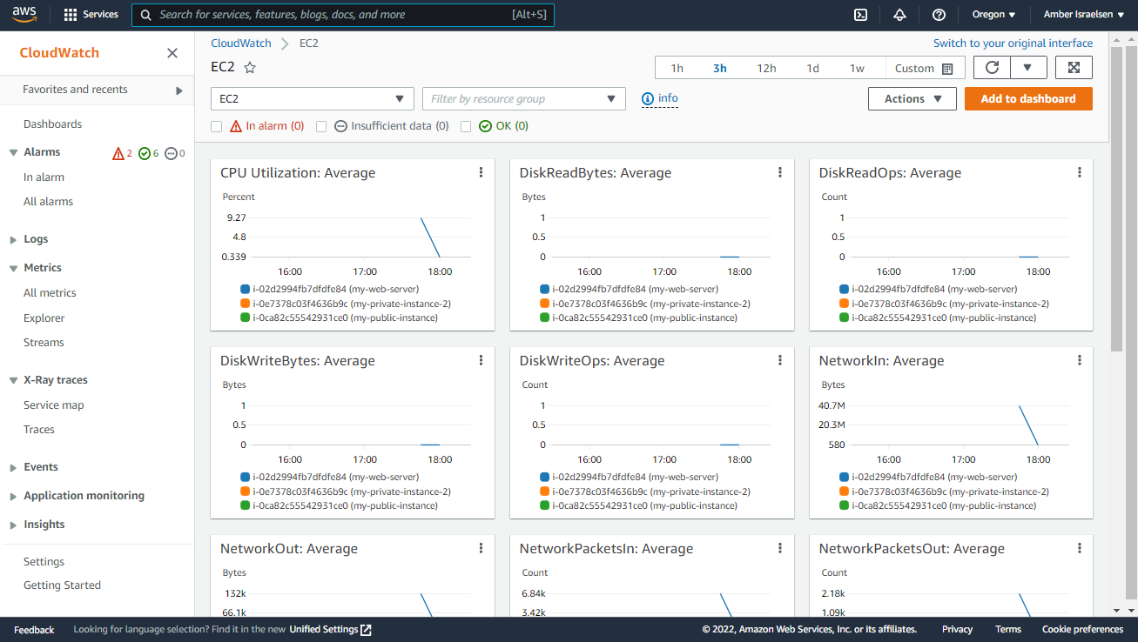
CloudWatch Dashboards
Can adjust timeframes (applies to all widgets)
Widget
Notes:
m11-09 = “CloudWatch Dashboards Overview”
We’ve seen various ways that we can drill into metrics, view alarms and such, but it would be really nice if everything were on a single dashboard so we could get an at-a-glance view of what’s going on, and any urgent things we need to deal with.
And that’s exactly what we get with CloudWatch Dashboards.
These are made up of widgets—and there are many you can include on the dashboard. And you can also adjust the timeframe for the overall dashboard, which will apply to all widgets shown.

Slide 22
CloudWatch Dashboards
Easy way to get an at-a-glance view of important metrics and alarms
Dashboards are global
They can include data from different AWS accounts and regions
Remember: Metrics are regional
Free, up to three dashboards
Notes:
As mentioned, these are a way to get an at-a-glance view of important metrics and alarms.
Dashboards ARE global, but they can include data from different accounts and regions. And as a reminder, the metrics are regional. So maybe you have a dashboard that displays everything in alarm, and you want to show alarms from us-west-2 and eu-south-1 and asia-pacific-east 1. That’s totally possible to do. The metrics are defined at the region level, but they can all be surfaced on the same global dashboard.
And dashboards are free, up to three.

Slide 23
DEMO
Working with CloudWatch Dashboards
Notes:
m11-10 = “DEMO: Working with CloudWatch Dashboards”
In this demo, we’ll take a quick lap around some standard CloudWatch dashboards that we get out of the box, and then we’ll also see how we can create our own custom dashboard.
CloudWatch dashboards
Automatic dashboards (top tab)
EC2
You can adjust the date/time range just like we’ve seen before (do this; and zoom in on some lines)
Note that you can also see the alarm status on the top too
Back up to Dashboards→Custom dashboards→Create
Name: MyFirstDashboard
Add widget: Number
S3-->NumberOfObjects in some bucket
Create
Adjust timeframe to see there’s something there
Add widget: Pie
Metrics
DynamoDB→Table→ProvisionedRead, ConsumedRead
Also, just to point out, we can pull metrics from other regions to add to the dashboard. Remember, dashboards are global, and can pull together metrics from other regions or even other AWS accounts.
Add widget: Line
Metrics
Change the region from Oregon to North Virginia
S3→pick something
Add to dashboard
You’ll see the “xa” shown on the top right of the widget, and that indicates it’s cross account, though it’s actually in my same account, but a different region.
Save dashboard
So those are the basics of CloudWatch dashboards. A lot more you can do here. But let’s delete this dashboard. Remember you get three for free, but let’s get rid of this one just to keep things clean

Slide 24



Logs
EC2 Instance
CloudWatch Logs
Logs
On-Premises Server
Notes:
m11-11 = “CloudWatch Agent Overview”
Let’s spend just a minute talking about the CloudWatch agent. By default, EC2 instances don’t send logs to CloudWatch logs, but you can imagine (click) that might be a useful thing to do.
And there might be a similar (click) need for an on-premises server to send its logs to CloudWatch Logs as well.

Slide 25
CloudWatch Agent
Logs
EC2 Instance
CloudWatch Logs
CloudWatch Agent
Logs
On-Premises Server
Notes:
The way that happens is that you need to install the CloudWatch agent on the servers. This collect logs from those servers, for both Linux and Windows operating systems, on-prem or in AWS, and ship them to CloudWatch logs.

Slide 26
CloudWatch Agent
“Unified” CloudWatch Agent
Can send logs AND metrics
Metrics are more extensive and more granular than those produced natively by EC2
e.g., memory or swap utilization
CloudWatch “Log” Agent is the older version, and can only send logs
Notes:
There are two flavors of the agent.
First is the Unified CloudWatch Agent, which can send logs—like we just talked about—but it can also send metrics. That’s why it’s unified, it can send both. And these metrics are going to be more extensive and more granular than those that are produced natively by EC2. A common one is memory utilization. By default, you can get things like CPU usage, disk and network usage, but if you want memory or swap usage, then you’ll need to use the CloudWatch Unified Agent.
And then the older version of the agent is called the CloudWatch Log Agent. And as you might have guessed, it can only send logs, and not metrics. It’s generally recommended to use the Unified version, but I wanted to mention this older CloudWatch Log Agent in case you see it on the exam.

Slide 27
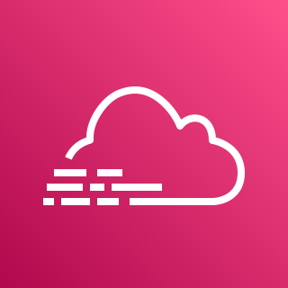
Amazon CloudTrail
Records user activity and API usage on your AWS account
Examples: Create an IAM role, terminate an EC2 instance, log into the Console
Primarily used for auditing
Automatically enabled
Saves a history of API calls made through:
AWS Management Console
CLI
SDKs
Higher-level AWS services (like CloudFormation)
Logs can be saved to CloudWatch or S3
Needed for storage longer than 90 days
Notes:
m11-12 = “CloudTrail Overview” – re-use m4-79
The second important service to know about as far as monitoring is called CloudTrail. Now, just to call it out up front, on the exam, you’ll probably get some questions that test whether you know this difference between CloudTrail and CloudWatch. I’ll summarize those at the end of this section, but let’s first overview what CloudTrail is.
CloudTrail records user activity and API usage on your AWS account. Remember, APIs are basically the code to make things happen in AWS. So if I go into the Console and create a new IAM role, that issues an API call—it calls code, basically—and that code creates the new Role. Or if I terminate an EC2 instances or even if I log into the AWS Console. All those actions are making API calls on the backend.
This is primarily used for auditing purposes. Say you’re investigating a security incident, let’s say, and trying to figure out who created a new keypair that was used to log into EC2 instances. CloudTrail would have logged that activity so you can backtrack and find it.
CloudTrail is automatically enabled on an AWS account.
It’ll save a history of API calls made through the AWS Management Console—so all the things we’ve been doing in the browser so far in this course, for example. Or if calls are made from the Command Line Interface or programmatically through the SDKs. And it also logs things from the higher-level AWS services—such as CloudFormation, which, you’ll remember, provisions and deletes AWS resources.
You can view the CloudTrail activity in the CloudTrail part of the Console, but it also integrates with CloudWatch or S3 if you want to send your logs there. And actually this is a requirement if you need to save logs longer than 90 days because they’re automatically deleted after that.

Slide 28
DEMO
Working with CloudTrail
Notes:
m11-13 = “DEMO: Working with CloudTrail” – re-use m4-80, but update badge
Navigate to CloudTrail, to Dashboard
Now, we’ll create a Trail here in a second, but even just from the dashboard here, you’ll see the event history—all the different things that have been going on in my account. View full event history.
So we ________ (point out some things). For each one, you can see when it happened—the date and time—the user who did it, the event source—so the service, basically, where the event took place, the type of resource and then the specific resource name.
So that’s the full event history of what’s been going on. And you’ll see the reminder here that this is showing the last 90 days. Now, these are what are called management events—we’ll see two other kinds of events here in a second.
Let’s go create a trail. Rather than getting all events, you can set up a trail to filter to only certain events, and you can also say, I want these events to be saved into CloudWatch or S3.
Trail name: my-demo-events
Create new S3 bucket (leave default name)
Deselect encryption
Deselect log file validation
You can configure CloudWatch to monitor your CloudTrail lots and then get alerted with a specific activity occurs. Enable this
New Role: MyCloudTrailRole
Next
Now you need to specify what kind of events you want to record. Management events are the ones we’ve been talking about—creating new resources, logging in, that kind of thing. These are enabled by default on your account, and they’re free. Data events would be something like reading or writing to an S3 bucket. These cost extra, as do Insight events. Insight events basically try to make sense of All the information coming out of CloudTrail, and find unusual activity or anomalies. This also costs extra. So we’re going to just go with management events.
Defaults on everything else and next
Create trail
So here we have a trail, and the output is being stored in an S3 bucket. It’s currently logging our activity.
Let’s go take some new action. Create a new EC2 instance.
Let’s first go to S3 to see that it’s logging things. Click on the S3 link. And there’s a GZ file here. If you were to Open this (using the bottom), you’ll see lots of things being logged.
But this is also being sent to CloudWatch logs because we enabled that. So let’s go take a look at a friendlier version there.
Go to log groups (left nav), filter by cloudtrail. Click on the top one. CloudTrail can sometimes take 5 minutes to log new things, so you might need to wait a while.
Filter by “instance”. Go to the last one. You’ll see here we have DescribeInstances (or whatever appears), which is when we went to view the instances we had. coming from the Console, the Root account was used—and a lot of other information here.
So that’s how you work with CloudTrail to track user and API activity on your AWS account. And hopefully it’s more clear now how this differs from CloudWatch, which you’d use to monitor the health and performance of your resources, like CPU usage, memory usage and those kinds of things.

Slide 29


CloudWatch vs. CloudTrail
CLOUDWATCH
CLOUDTRAIL
Performance monitoring of applications and resources
Metrics such as CPU, network, disk, GPU utilization
Captures user activity and API calls on an AWS account
Activity such as creating new resources, terminating resources, logins, etc.
Notes:
m11-14 = “CloudWatch vs. CloudTrail”
Now let’s talk briefly about the differences between CloudWatch and CloudTrail.
CloudWatch is really used for performance monitoring of applications and resources. So you want to know what your CPU utilization is on an EC2 instance or network in and out, or disk reads or writes, GPU utilization and so on.
And then CloudTrail is concerned with user activity and API calls at the AWS account level. So who’s creating new resources, who’s terminating them or logging in or creating new IAM users, that kind of thing.
I like to think of CloudTrail in the context of a security incident--that the bad guys would leave a TRAIL of trying to log in into your account or database and do something nefarious in your account. Now, CloudTrail activity doesn’t HAVE to be related to just security incidents, but that might help you remember the difference between the two. The trail that they leave behind from their actions.

Slide 30

AWS Config
Inventory, record and audit the configuration of your AWS resources
Example use cases:
Inventory all your S3 buckets, and when one of them becomes publicly accessible, receive an alert
Receive an alert when an unauthorized port opens on a security group
During a compliance audit, show when configurations changed
Notes:
m11-15 = “AWS Config Overview” – re-use m3-23
Now let’s talk about AWS Config, which is a service that effectively lets you inventory, track and audit the configuration of your various AWS resources.
-For example, you can get an inventory of all your S3 buckets, and when one of them becomes publicly accessible, you can receive an alert about it
-Or receive an alert when an unauthorized port opens on a security group
-Or during a compliance audit, you can show when configurations changed. The compliance piece is actually huge here because you have a record of what changed and when.
I think this one makes most sense when you see it in action, so let’s go out to the Console and have a look.

Slide 31
DEMO
Working with AWS Config
Notes:
m11-16 = “DEMO: Working with AWS Config” – re-use m3-24, but update badge
Go to AWS Config
View dashboard (if you haven’t used it before, you’ll say Get Started) – know that this is a paid service, so feel free to just watch for this demo
Settings→Start recorder (this will be different if it’s the first time you’re setting things up, but the rest of these things on this page will be the same as far as selecting resources, creating rules and so on)
Record specific resource types
-AWS resources
-S3 bucket
Create a role
Create a bucket to store the data that Config collects
If you want to receive alerts when configurations change, you can enable that here with the Simple Notification Service, but I’ll skip that for this demo. Save
Create a rule (have to do this as a separate step if you’re not in the initial Setup mode)
A rule basically says, this is the configuration I want, and AWS Config, I want you to monitor to make sure that all my resources match that rule.
Tons of rules – let’s just select one for when an S3 bucket becomes public, filter by S3
-s3-bucket-level-public-access-prohibited
So these rules will check that our buckets DO prohibit public read and write access, and if and when they don’t—when that configuration changes—we’ll be alerted.
Next, Confirm
Okay, now on your dashboard, you’ll see that it’s inventorying our S3 buckets. It might take a minute to do this, so you might need to refresh your page. You’ll see there are ___ buckets that it’s monitoring now. And we should also see that we have compliant rules; nothing is currently non-compliant.
Now let’s go add a bucket and see that it gets picked up. Add S3 bucket
-testing-aws-config-date
-Block public access for now
Refresh AWS Config and show that it picked up the new bucket in inventory (might take a few minutes). And you’ll see that it’s compliant, though I do have some other SageMaker buckets I was using that are open to the public so those are showing non-compliant. But let’s go change the new bucket we created so that it’s open to the public.
Now let’s go change that. Maybe somebody accidentally opens up public access and/or a bad actor does it on purpose. Update bucket to allow public access (in the bucket, Permissions→Edit). Now back in Config, it’s monitoring for changes like that because we have those as active rules. In Config, go to Rules, select the rule, then Action→Re-evaluate. Click into rule to find non-compliant.
You’ll see that our new bucket is not compliant anymore. If you click into it, then click on Resource Timeline, you’ll see at what point that happened. So this is where compliance and audit comes in. If you had, say, a breach of an S3 bucket and customers’ data was stolen or something like that, auditors would definitely want to know what happened and when, and they’d want to know that you remediated the issue. And AWS Config records everything that’s happening so you’ll be able to provide this data to auditors.
Back in S3, block public access again
In Config, go to Rules, select the rule, then Action→Re-evaluate
Show that the resource timeline is updated (show the configuration change on top of the timeline)
Under Settings→stop recording
Delete rules
Delete S3 bucket

Slide 32
Important Points to Remember
CLOUDWATCH
Used for performance monitoring of applications and resources
e.g., CPU, network, disk, GPU utilization
Alarms are used to send notifications when metrics hit some threshold
The Unified CloudWatch Agent can send logs AND metrics from EC2 and on-premises servers
Required to get memory usage information
CLOUDTRAIL
Captures user activity and API calls
e.g., who created an EC2 instance, who terminated an EC2 instance, who logged into the Console
CloudTrail logs can be sent to CloudWatch for monitoring and alerting
AWS CONFIG
Used to inventory resources and record the configuration/changes
Notes:
m11-17 = “Important Points to Remember”
CLOUDWATCH
Used for performance monitoring of applications and resources
e.g., CPU, memory, disk, GPU utilization
Alarms are used to send notifications when metrics hit some threshold
The Unified CloudWatch Agent can send logs AND metrics from EC2 and on-premises servers
CLOUDTRAIL
Captures user activity and API calls
e.g., who created an EC2 instance, who terminated an EC2 instance, who logged into the Console
CloudTrail logs can be sent to CloudWatch for monitoring and alerting
AWS CONFIG
Used to inventory resources and record the configuration/changes

